Slide 1

Health SIRG Meet and Greet

Slide 2
Agenda
Welcome
Short introduction Officers
    Chair – Esther Bakker-van Gijssel
    Co-chair – Jenneken Naaldenberg
    Secretary/Treasurer – Genevieve Breau
    Members at Large – Laurance Taggart, Eva Flygare Wallen, Helene Ouellette-Kuntz, Emily Lauer, Reece Adams, Thessa Hilgenkamp, Henriette Trip, Bill Sullivan, Ashlyn Smith
Update 2020
Notes:
Chair – Esther Bakker-van Gijssel researcher/ID physician at the Radboud university medical center and Medical director Siza
Co-chair – Jenneken Naaldenberg associate professor Rabouduniversity medical center
Secretary/Treasurer – Genevieve Breau lecturer in public health, school of Human sciences, University of Greenwicht
Members at Large –
Laurance Taggart, Lead, Centre for Intellectual and Developmental Disabilities, Ulster University
Eva Flygare Wallen, Academic Primary Health Care Center, Stockholm County Council
Helene Ouellette-Kuntz, Professor, Dept. of Public Health Sciences, Queen’s University Kingston, Ontario, CANADA
Emily Lauer, Director, Center for Developmental Disabilities Evaluation and Research (CDDER) Eunice Kennedy Shriver Center, University of Massachusetts Medical School
Reece Adams, Head, Centre for Developmental Disability Health – Monash Health Melbourne, AUSTRALIA
Thessa Hilgenkamp, assistant Professor, Dept. of Physical Therapy, University of Nevada
Henriette Trip, Senior Lecturer, Centre for Postgraduate Nursing Studies, University of Otago Christchurch, New Zealand
Bill Sullivan Associate Professor, Dept. of Family and Community Medicine, University of Toronto
Ashlyn Smith Special Olympics International

Slide 3
Agenda
Date | Event | Collaborator(s) | Leader(s) | Planned / Completed
2020 | Webinars with COVID-19 | Ethics SIRG, Mental Health SIRG | Bill Sullivan | Complete, links to webinars on Health SIRG webpage
2020 | Newsletter on physical activity |  | Thessa | Complete, mailed to Health SIRG membership and saved to Health SIRG website
2020 | Health Conference in Toronto |  | Health SIRG Executive | Planning was done, but decision to cancel conference due to COVID-19 made in April 2020
2020 | Health conference in Toronto |  | Health SIRG Executive | Reviewed abstracts: accepted abstracts to be presented at Amsterdam conference (Genny to confirm number of abstracts to be presented at Amsterdam conference)
2020 | IASSIDD Asia Pacific conference |  | Health SIRG executive | Some members of the executive reviewed abstracts for this conference although it was cancelled due to COVID-19
2020 | Position paper on COVID-19 |  | Esther Bakker-van Gijssel and others | Position paper on COVID-19 sent to board
2020, 2021 | JPPIDD editorial board |  | Laurence Taggart, Jenneken Naaldenberg | Two members of the SIRG are on the editorial board of the journal, other members are reviewers for the journal
2021 | IASSIDD European Congress |  | Health SIRG executive | Some members of the executive reviewed abstracts for the European congress
2021 | IASSIDD consensus statement on diabetes care |  | Laurence Taggart and others | Health SIRG released consensus statement on managing type 2 diabetes in adults with IDD
2021 | JPPIDD special issue on COVID-19 |  | Laurence Taggert and others | Special issue on COVID-19 to be released in 2022
2021 | IASSIDD Health SIRG AGM |  | Esther Bakker-van Gijssel | Health SIRG to hold AGM during Amsterdam conference
2021 | IASSIDD Health SIRG mini-conference |  | Esther Bakker-van Gijssel | Health SIRG executive planning for an online webinar/mini conference to be held in 2022
Notes:
I know, this is a totally wrong example of how you present results in powerpoint. You can’t even read it. The reason why I present this table is to show you how active our Health SIRG is!
In 2020, mind you the COVID year ,
we organised a webinar series togehter with two other SIRGs,
besides we organised a health SIRG conference which had to be canceled due to COVID-19. So sad.
We have published a newsletter with an update of all research done on physical activity. And if you see the figures I presented at the keynote session on Tuesday with 48% of overweight in people with ID suffering from COVID-19 you know that this is a very important topic.
Our executives reviewed many, many abstracts of diverse conferences/congresses
And so on

Slide 4

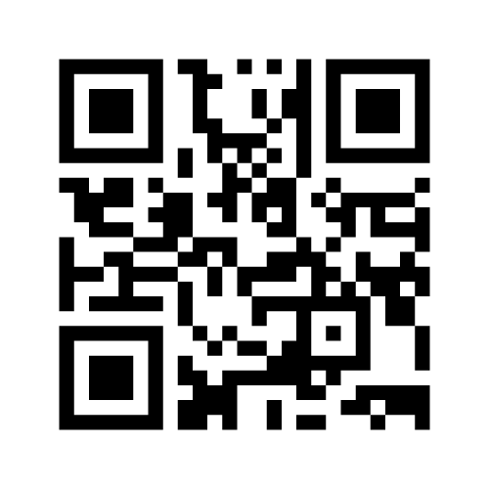
Agenda
4. How to increase IASSIDD/Health SIRG membership?
  Answers (multiple possibilities):
  1. via chat congress page
  2. Or QR code:
  3. Or Go to menti.com and use code 6302847
  4. Or https://www.menti.com/m51xwnu7pc
Notes:
We would like to ask you some suggestions about how to increase IASSIDD /health SIRG membership.
The reason we ask this question is of course that we want to conitnue these kind of conferences in the future. You can imagine that organising such a conference, but also through the year, keeping the IASSIDD website updated, organising webinars etc will cost a lot of money payed by the financial contribution of members.
You could answer to this question in three different ways:
Via 1.via the chat on the conference website
2. Use the QR code on this slide
3. Or Go to menti.com and use code 6302847
4. we have punt a link in the chat, the same link that is mentioned on this slide

Slide 5
Agenda
5. Which Subjects/topics should be presented in the Health SIRG webinar September 2022?
  Answers (multiple possibilities):
  1. via chat congress page
  2. Or QR code:
  3. Or Go to menti.com and use code 6302847
  4. Or https://www.menti.com/m51xwnu7pc
Notes:
Next year, in 2022, there won’t be a international conference nor a continental conference. Every month a IASSIDD webinar will take place, hosted by one of the special interest research groups.
The Health SIRG will be host in september 2022.
Again I have a question for you.
5. Which Subjects/topics should be presented in the Health SIRG webinar September 2022?
Please go ahaed in answering this question

Slide 6
Agenda
5. Articles, position statements and special editions of JPPID on health
6. Health SIRG funds/finance
7. Any questions, remarks? Please use the congress chat
8. Date of Next Meeting : Chigago 2023
Notes:
5. Articles, position statements and special editions of JPPID on health
I have told you already about our newsletter, to be found on the IASSIDD website
In the beginning of next year there will be a special issue of JIPPIDD. Our executives together with their colleagues of the diverse universitiies have written articles on this topic. This will be a free access publication
A IASSIDD concensus statement on diabetes care and on COVID-19 was made
6. Health SIRG funds/finance
Anything to add Genny??
7. Date of Next Meeting : Chigago 20238. If you have any questions or remarks please use the chat.

Slide 7

Notes:
Thank you for attending this meet and greet

